Slide 1
Design of Reflection Microscopy with different lenses as objective lens

Slide 2
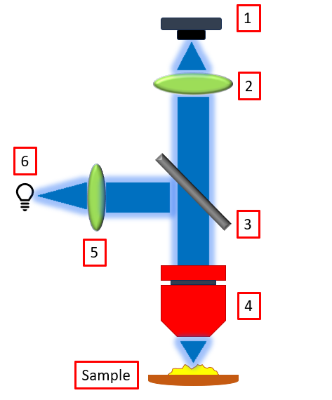
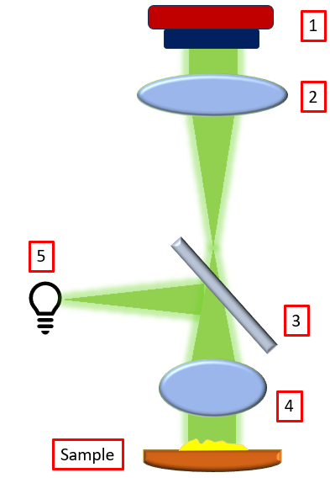
Layout 1
Layout 2
Smartphone camera as detector
Plano-convex lens as Tube lens
Beam splitter 70:30 (R:T) BST10
Microscope objective
Collimating lens
LED as light source
Smartphone camera
Plano-convex lens
Beamsplitter 70:30 (R:T) BST10
Achromatic doublet or Ball lens
LED as light source

Slide 3
 | First Layout |  | Second Layout
1 | Smart Phone Camera as detector | 1 | Smart Phone Camera as detector
2 | Plano-convex lens as tube lens (D= 6 mm, f= 11 mm) (#37-775) | 2 | Plano-convex lens as tube lens (D= 6 mm, f= 11 mm) (#37-775)
3 | Beamsplitter 70:30 (R:T) (BST10, Thorlabs) or (#45-314, Edmund Optics) | 3 | Beamsplitter 70:30 (R:T) (BST10, Thorlabs) or (#45-314, Edmund Optics)
4 | Microscope Objective RMS10X, Thorlabs | 4 | Ball lens (d= 3mm) (#43711, EO) or Achromatic doublet lens (d= 4 mm, f= 6 mm) (#63–714, EO)
5 | Collimating lens (PCX #45-083 EO) or (LA1576 Thorlabs) | 5 | 1W LED as light source
6 | 1W LED as light source

Slide 4
 | Mount | Source
Beamsplitter | KCB1C for BST10, Thorlabs | https://www.thorlabs.com/right-angle-kinematic-mirror-mounts-for-30-mm-cage-systems
Microscope objective (RMS10X, Thorlabs) | KM100R | https://www.thorlabs.com/kinematic-microscope-objective-mount
Plano-convex lens | (a) 64-555 for (45-083 ,f=12 mm, d= 12mm) (b) 64-552 for (37-775 , f= 11mm, d= 6mm) | https://www.edmundoptics.in/p/120mm-optic-diameter-optic-mount/19267/ https://www.edmundoptics.in/p/60mm-optic-diameter-optic-mount/19264/
Achromatic doublet lens | AC050-008-A-ML 63–714 | https://www.thorlabs.com/mounted-achromatic-doublets-ar-coated-400---700-nm Not found
Ball lens | Not found
Power supply | USB-OTG cable or 9V battery with battery snapper and resistor

Slide 5
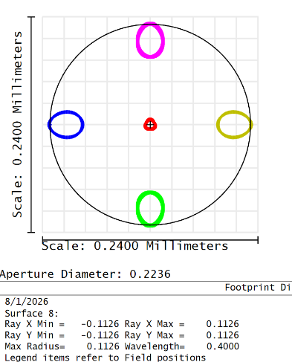
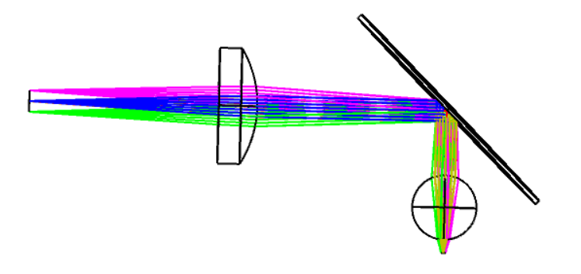
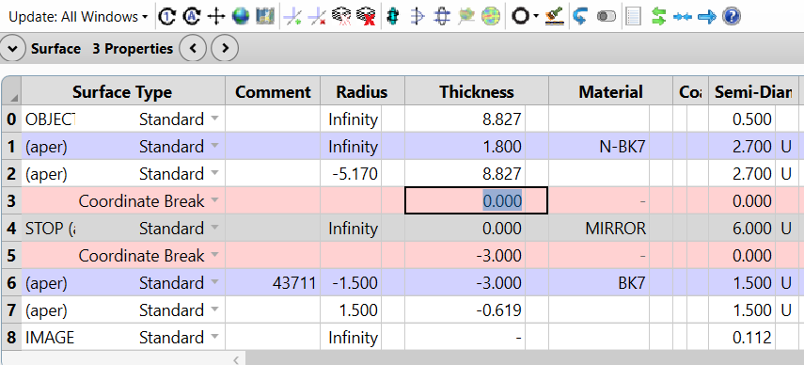
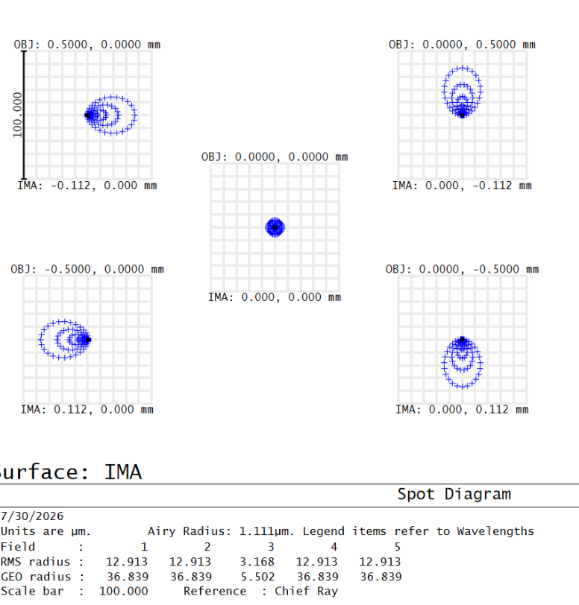
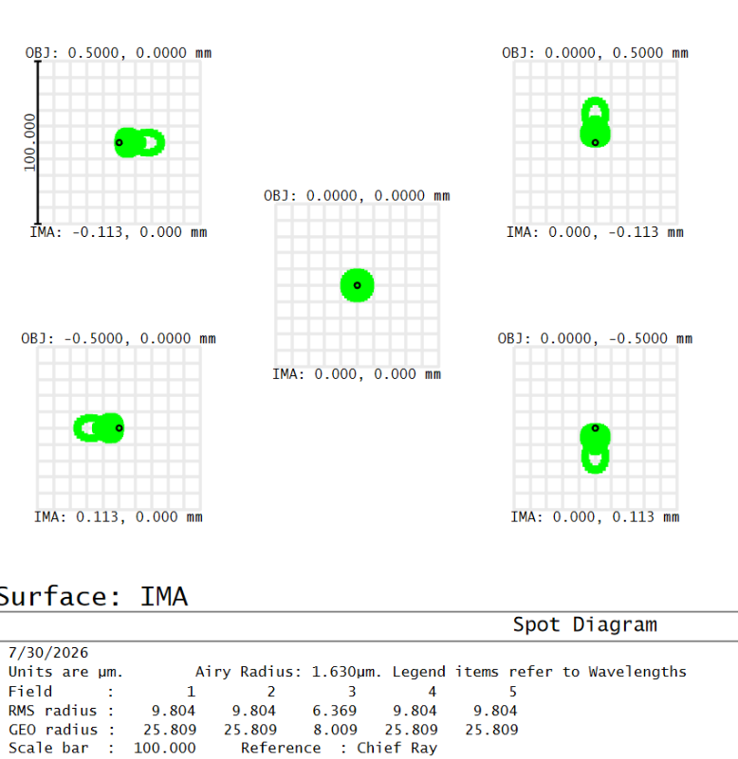
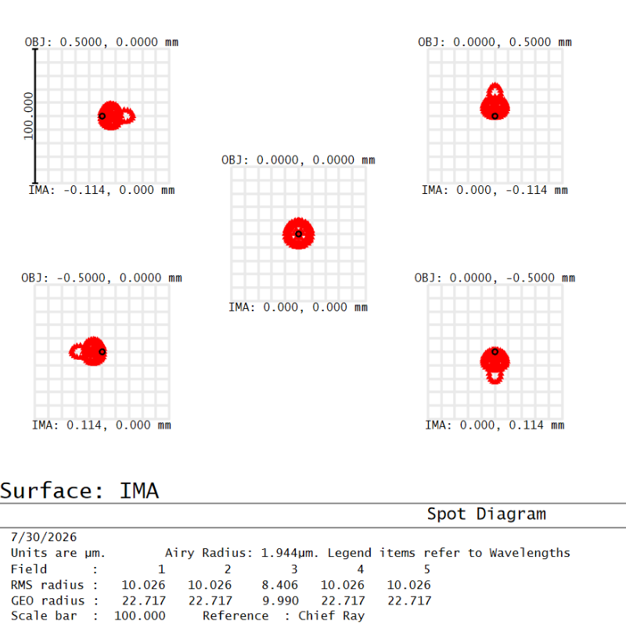
Design with Ball Lens as objective
Fig (a) 2D Layout
Fig (b) Lens Data Editor
Fig (f) Footprint diagram
Fig: Spot diagram of wavelength (c) 400 nm (d) 587 nm (e) 700 nm

Slide 6
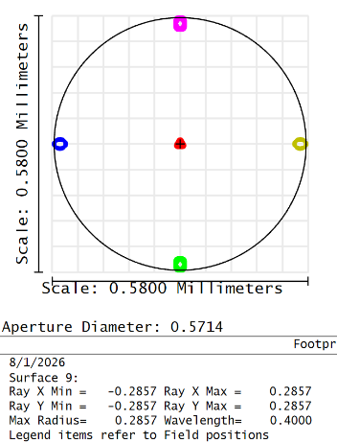
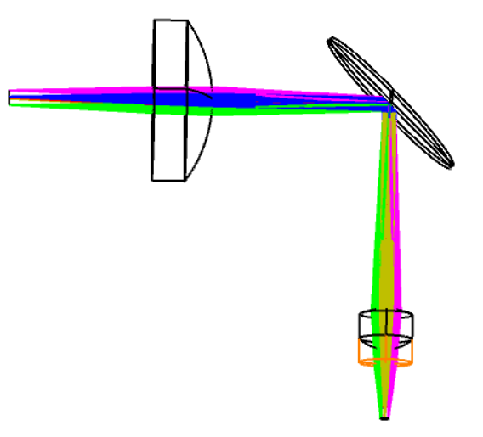
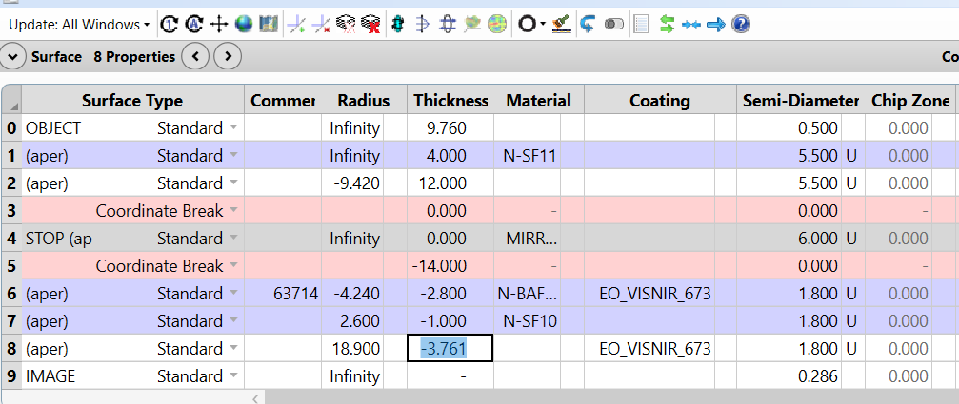
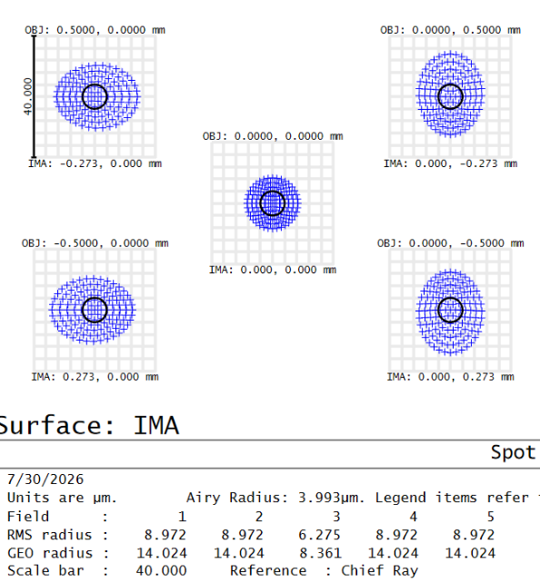
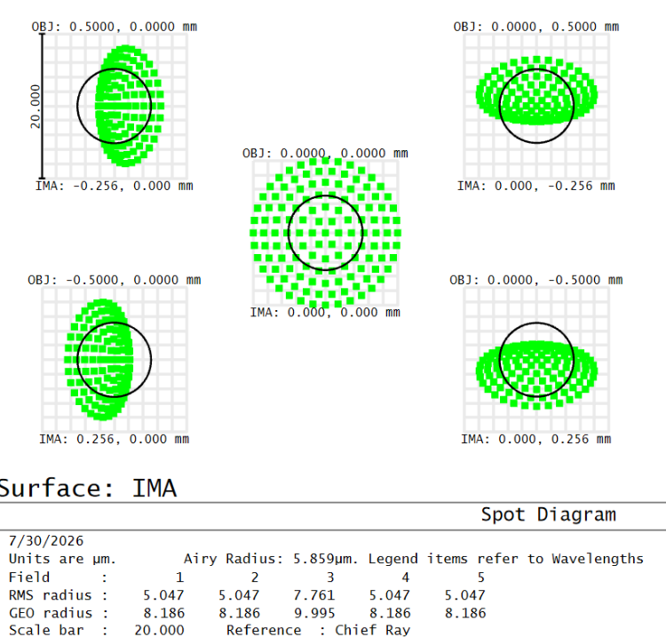
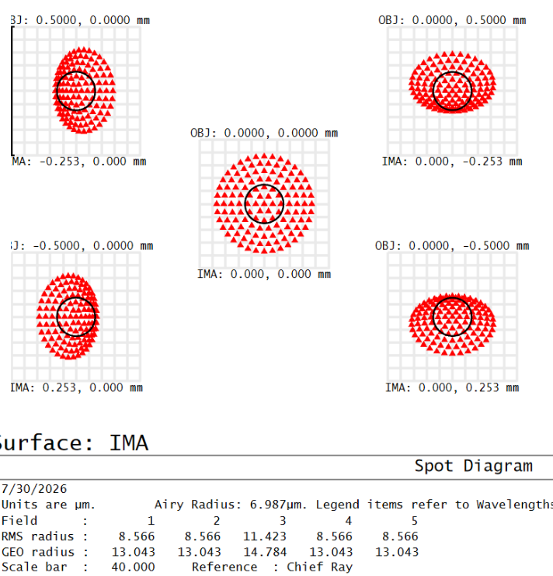
Design with Achromatic Lens
Fig (a) 2D Layout
Fig (b) Lens Data Editor
Fig (f) Footprint diagram
Fig: Spot diagram of wavelength (c) 400 nm (d) 587 nm (e) 700 nm

Slide 7
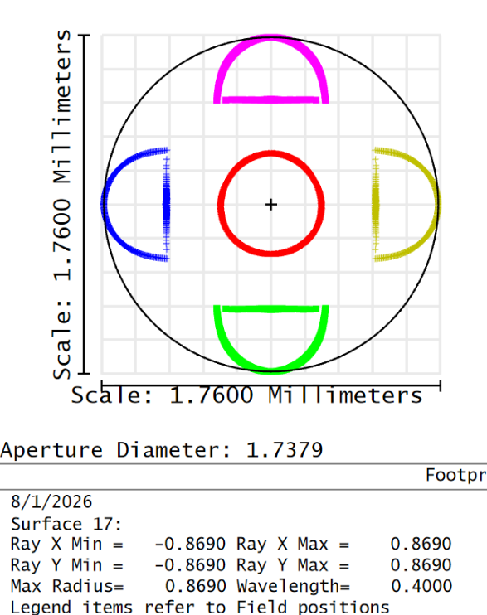
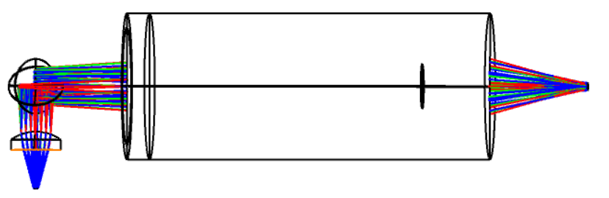
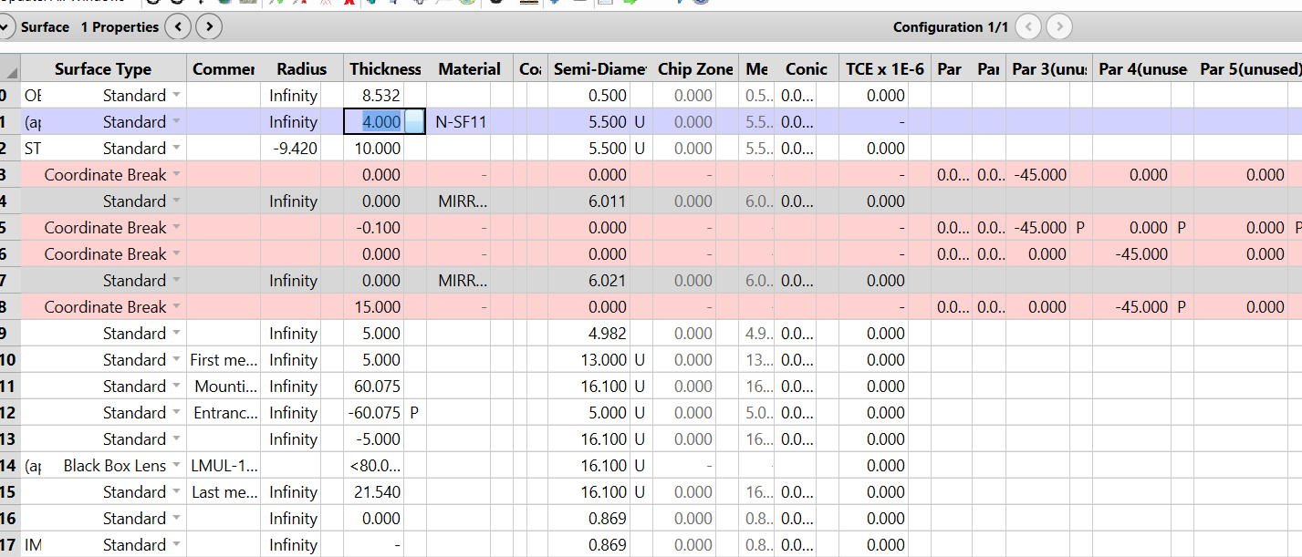
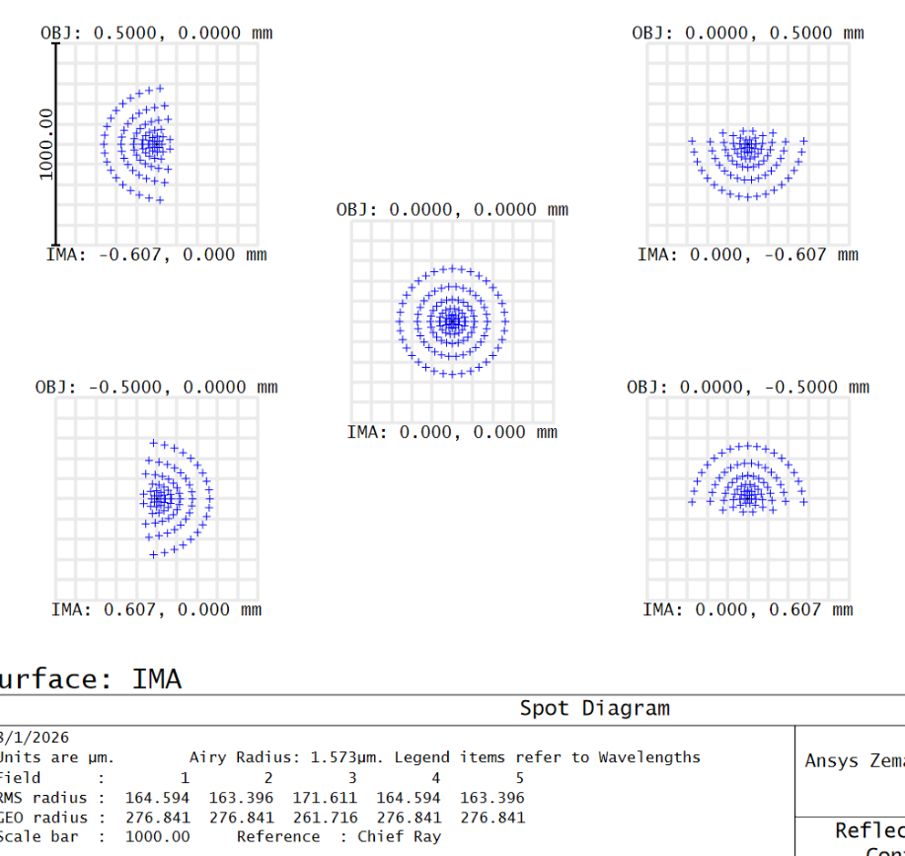
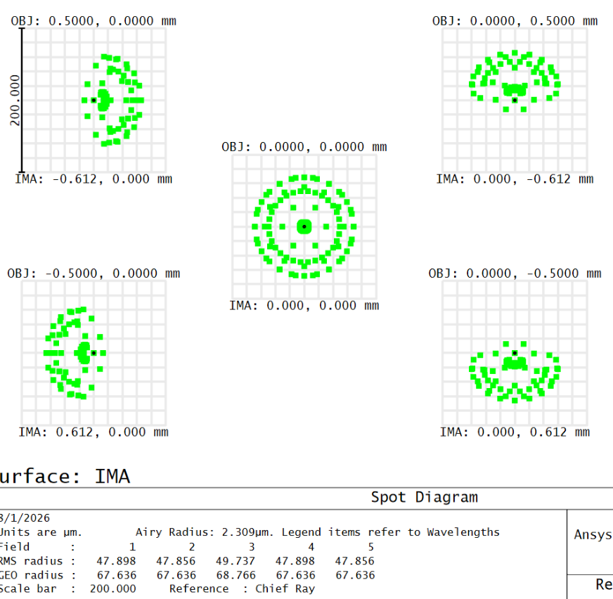
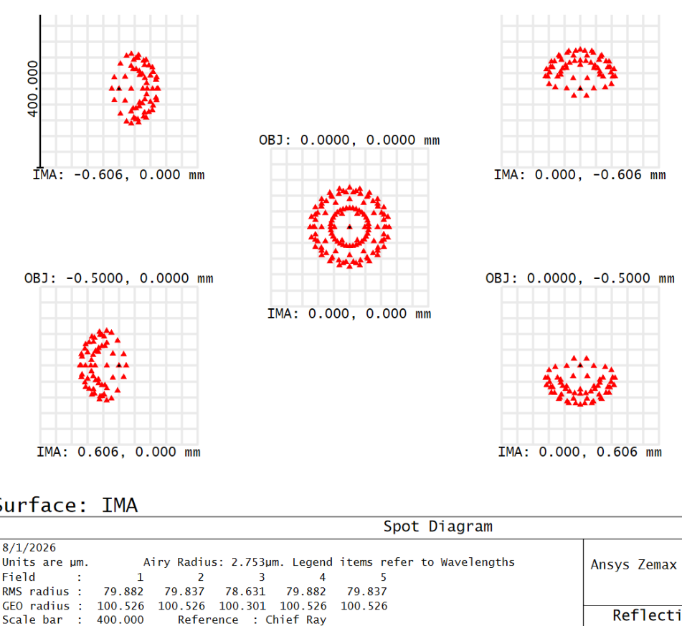
Design with Microscopic objective
Fig (a) 2D Layout
Fig (b) Lens Data Editor
Fig (f) Footprint diagram
Fig: Spot diagram of wavelength (c) 400 nm (d) 587 nm (e) 700 nm

Slide 8
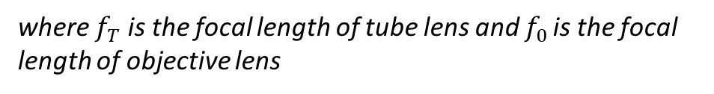

Comment
Magnification of system using ball lens as objective lens
M(total) = M1 × M2
M1 = 1000 (n −1) n/D is the magnification obtained from the ball lens where n is the refractive
index and D is the diameter of the ball lens and M2 = 1 + d /f is the magnification due to the PCX lens used.
M(total) = 171x
2. Magnification of system using achromatic lens as objective lens
$$M=\frac{f_{T}}{f_{0}}= \frac{11}{6 }=1.83x,$$
where $f_{T}$ is the focal length of tube lens and $f_{0 }$is the focal length of objective lens

Slide 9
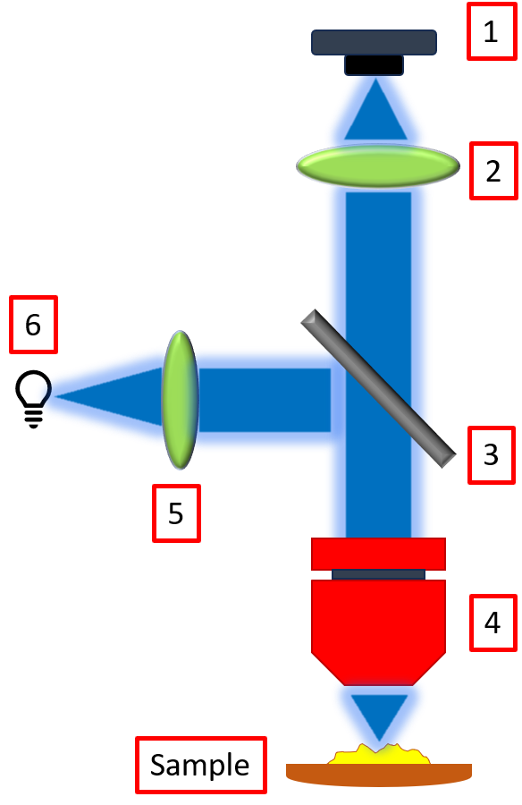
1
2
5
3
4
Sample

